Slide 1
Fred Kaffenberger
February 9th, 2016
Notes:
Purpose of this presentation: Describe the capabilities of Power BI Desktop
Target audience: BI analysts and BI-focused IT professionals

Slide 2
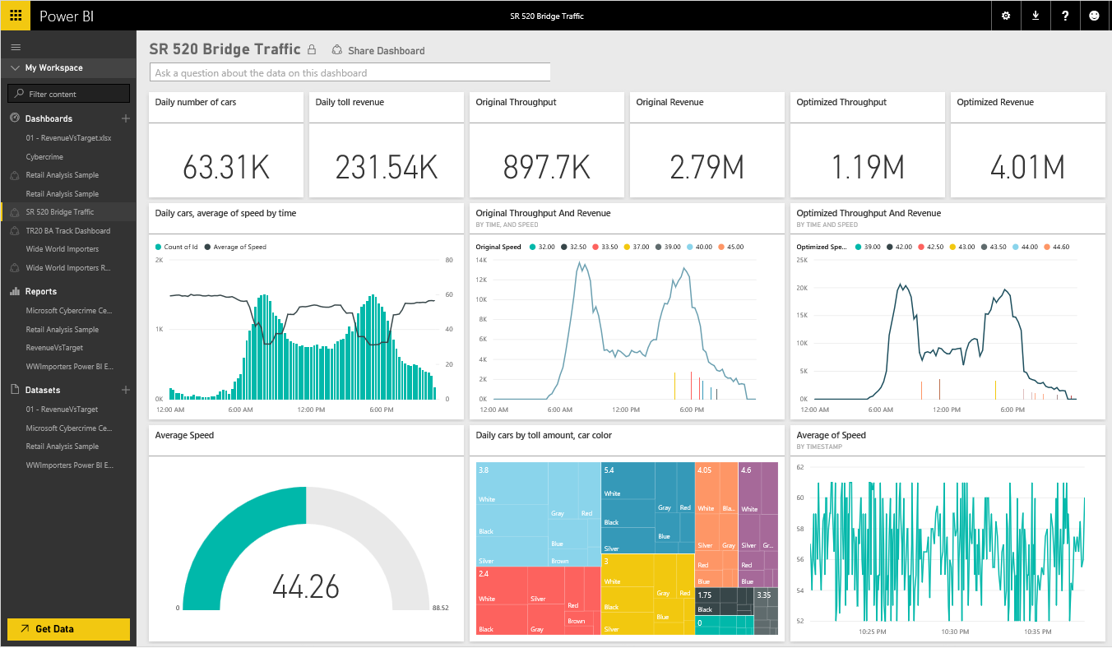
Power BI
Experience your data. Any data, any way, anywhere
Power BI is a cloud-based business analytics service that enables
fast and easy access to your data
a live 360º view of your business
data discovery and exploration
insights from any device
collaboration across your organization
anyone to visualize and analyze data
Notes:
Key message:
Power BI is a business analytics service. With Power BI you can now see all of your data through a single pane of glass. Live Power BI dashboards and reports show visualizations and KPIs from data residing both on-premises and in the cloud, providing a consolidated view across your business regardless of where your data lives.
Talking points:
This is Power BI in a nutshell and the overall benefits to your business. We will look at what this means for the IT Pro and the key benefits for IT on the next slide

Slide 3

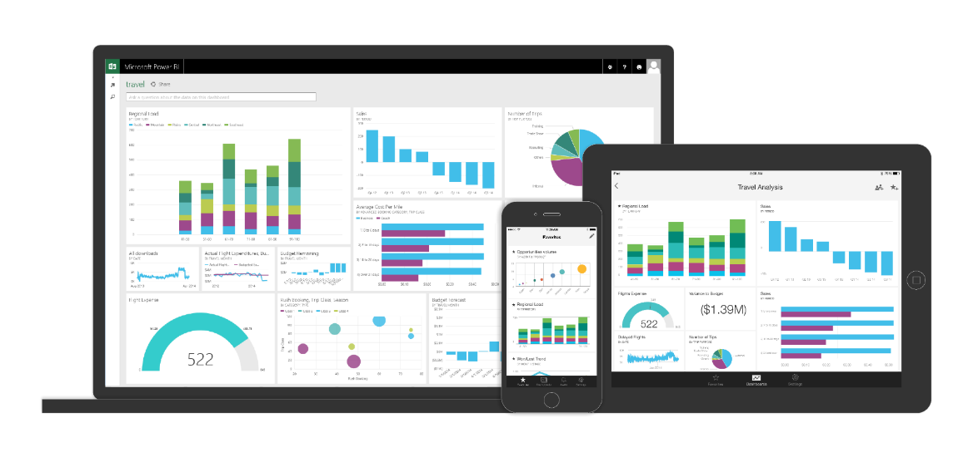
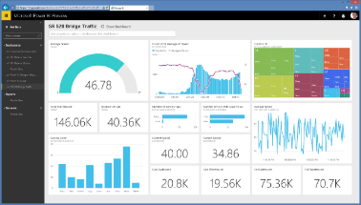





Key benefits and differentiators of Power BI
Pre-built dashboards and reports for popular SaaS solutions
Real-time dashboard updates
Secure, live connection to your data sources, on-premises and in the cloud
Intuitive data exploration using natural language query
Integrated with familiar Microsoft products and utilizes commitment for scale & availability in Azure
Fast deployment, hybrid configuration, secure, and integrated with existing IT systems.
Notes:
Key message:
There are several capabilities that differentiate Power BI from other offerings in the market.
Talking points:
Power BI is a cloud-based analytics service that provides faster time to insight. It is used for visualizing, exploring and extracting insights from data. It brings together data from diverse sources to deliver rich, comprehensive views of business operations.
What that means is, with Power BI, you can see all of your data through a single pane of glass, and create an analytics environment in minutes to monitor data and share reports. Live dashboards and reports show visualizations and KPIs from data that reside both on-premises and in the cloud, providing a consolidated view across your business regardless of where your data lives.
There are several capabilities that are unique to Power BI – these include:
Pre-built dashboards and reports for popular SaaS solutions such as Marketo, Salesforce, GitHub, ZenDesk, Dynamics CRM, and many others
Dashboards and visualizations that support real-time updates
Secure, live connection to on-premises data sources to drive insight across the entire range of organizational information (Analysis Services, Azure SQL Database, SQL Database Auditing, Azure SQL Data Warehouse)
Automated scheduled refresh to keep your Power BI data in sync with on premises data sources
Native mobile applications for keeping users connected on the go
Easy integration with other Microsoft offerings, from Excel to Azure services
Intuitive data exploration, which enables users to ask questions of their data in plain English
To summarize, Power BI is a SaaS offering that enables anyone to easily connect to their data, create live operational dashboards and explore data via interactive visualizations

Slide 4



Power BI Overview
Power BI
Data sources
Power BI service
SaaS solutions
e.g. Salesforce, GitHub, Google
Content packs
Natural language query
Sharing & collaboration
On-premises data
e.g. Analysis Services
Live dashboards
Organizational content packs Corporate data sources or external data services
Visualizations
Azure services
Azure SQL, Stream Analytics…
Reports
Excel files
Workbook data / data models
01001
10101
Power BI Desktop files
Data from files, databases, Azure, and other sources
Datasets
Data refresh
Notes:
Let’s walk through an overview of how Power BI works.
1. The Power BI service, sometimes referred to as powerbi.com, is what allows you to:
Create beautiful visualizations to tell compelling data stories
Build rich, live dashboards that turn BI into business insights
Create reports & datasets from which you can create visualizations and dashboards
Enjoy the benefits of up-to-date data with real-time, automatic and scheduled refreshes
Share dashboards easily with other people in your organization
Ask questions of data in plain English with Natural Language Query
Stay connected to your data all the time with mobile applications
2. Power BI connects to a variety of data sources. These range across both cloud and on-premises sources, and include:
A variety of popular SaaS solutions, such as Marketo, Salesforce, GitHub, Dynamics CRM, Zendesk, and several others
On-premises databases – Power BI offers live connectivity to SQL Server Analysis Services, which we’ll cover in more detail later. And using a gateway solution, Power BI can connect to other database solutions.
Custom data sources – Power BI can connect to any data source you need it to thanks to its extensibility via REST APIs. This includes both proprietary corporate data sources, as well as external data services. For example, if you are a SaaS solution provider, you can work with Microsoft to connect your solution to Power BI.
Other Azure services – Power BI integrates tightly with SQL Azure and Stream Analytics, and will be integrating closely with more Azure services over time
Power BI Desktop and Excel files – Excel workbooks can be directly connected to Power BI.com, or may be used with Power BI Desktop. Power BI Desktop is a companion application to the Power BI service – it is a desktop tool that supports data analysis and reporting. Like Excel files, Power BI Desktop files may be uploaded to the Power BI service.

Slide 5

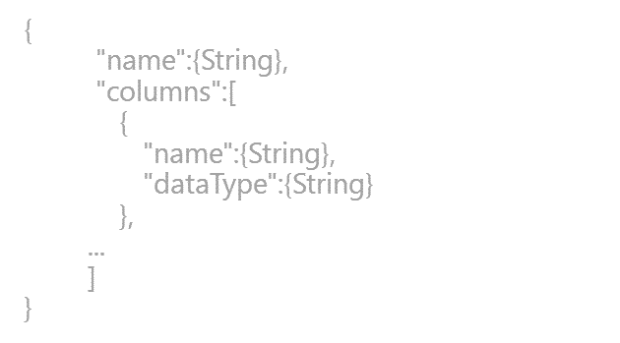
Power BI Overview
Power BI
Data sources
Power BI service
SaaS solutions
e.g. Salesforce, GitHub, Google
Content packs
Natural language query
Sharing & collaboration
On-premises data
e.g. Analysis Services
Live dashboards
Organizational content packs Corporate data sources or external data services
Visualizations
Azure services
Azure SQL, Stream Analytics…
Excel files
Workbook data / data models
Reports
01001
10101
Power BI Desktop files
Data from files, databases, Azure, and other sources
Datasets
0110001
00010110
Data refresh
Power BI Desktop
Power BI REST APIs
Prepare
Explore
Report
Share
Notes:
There is more….
3. Power BI Desktop is a visual data exploration tool that enables you to analyze data and create stunning reports. With Power BI Desktop, you are able to:
Acquire and prepare data using extensive query capabilities
Manipulation and consolidation of multiple data sources is performed in Power BI Desktop – this enables Power BI service users to use data from multiple sources in a single report
Establish data structure, then transform and analyze data
Visualize and explore your data in new ways through a freeform drag-and-drop canvas
Author reports with a broad range of modern data visualizations
Publish beautiful, interactive reports directly to powerbi.com
Securely share reports through unique, curated content library approach
4. Finally, the Power BI REST API library allows you to customize nearly every aspect of Power BI, including connecting to custom data sources, enabling real-time data streaming from your data source to Power BI, and integrating other applications with Power BI

Slide 6
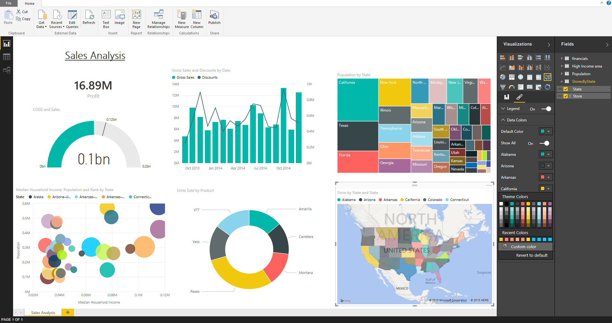
Create Power BI Content Connect to data and build reports for Power BI
What is Power BI Desktop ?
A free downloadable 32/64 bit desktop application optimized for the Power BI Service
Combines the power of Power Query, Power Pivot and Power View
Dedicated BI workflow: Specializing in Interactive Visualization and Analysis
Main output: Interactive Reports
Effortlessly publish interactive visual reports to Power BI users
Support: Monthly updates
Notes:
Power BI Desktop is a visual data exploration and interactive reporting tool, providing a free-form canvas for drag and drop exploration of your data, an extensive library of interactive visualizations, and an authoring experience for ease of report creation for the Power BI service.
A freely downloadable 32/64bit desktop application optimized for use the Power BI Service
Combines the Power of Power Query, Power Pivot and Power View
Specializing in Interactive Visualization and Analysis.
Main output: Interactive Reports
Effortlessly publish interactive visual reports to users of Power BI
Updated on monthly basis
Excel 2013 is Microsoft’s premier business analyst tool – it includes rich business intelligence features (Power Query, Power Pivot, Power View, Power Map) fully integrated with the powerful ad hoc analysis capabilities and familiar features of Excel – like Pivot Tables and Excel Charting. With Excel 2013, analysts can publish Excel Workbooks to Power BI, sharing data, analysis and reports with users of Power BI.
For customers who don’t have access to Excel 2013, the new Power BI Desktop can be used to import and model data, then author and publish Power BI Reports to the Power BI service. While lacking the rich analytical features of Excel, it does provide a simple solution expressly design for Power BI content creation.

Slide 7

Prepare, explore, report and collaborate with Power BI Desktop
Power BI Desktop
Prepare
Acquire and prepare data with extensive query capabilities
Establish data structure and transform and analyze data
Explore data in new ways through a freeform, drag-and-drop canvas
Author reports with a broad range of modern data visualizations
Publish interactive reports to Power BI
Explore
Report
Available as a free, downloadable desktop companion to the Power BI service, Power BI Desktop is a visual data exploration and reporting tool
Share &
collaborate
Notes:
1) Data preparation…. Get data, then transform and model
2) Exploration: Free form data exploration, canvas experience.
3) Report … Create interactive reports
4) Share and collaborate with Power BI
Power BI Desktop is a free desktop companion application for the Power BI service. It enables visual data exploration and report-authoring. Complementary to Excel, it combines the capabilities of Power Query, Power Pivot & Power View into a single interface.
With Power BI Desktop, you can:
Acquire and prepare data using extensive query capabilities
Manipulation and consolidation of multiple data sources is performed in Power BI Desktop – this enables Power BI service users to use data from multiple sources in a single report
Establish data structure, then transform and analyze data
Visualize and explore your data in new ways through a freeform drag-and-drop canvas
Author reports with a broad range of modern data visualizations
Publish beautiful, interactive reports directly to powerbi.com
Securely share reports through unique, curated content library approach

Slide 8
Power BI Desktop
Consolidate data from a broad range of sources
Use Query functionality to connect to data from a variety of sources beyond those available from powerbi.com
Navigate data quickly with in-memory processing that optimizes performance
Pare down datasets to only what’s needed by editing queries before data loading
Ability to automatically find related tables when connecting to database sources
Prepare
Explore
Data sources available through Power BI Desktop
Report
File | Database | Azure | Other
Excel CSV XML Text Folder | SQL Server Direct Query for SQL Server Access SQL Server Analysis Services Oracle IBM DB2 MySQL PostgreSQL Sybase Teradata | SQL Database Direct Query for SQL Database SQL Data Warehouse Marketplace HDInsight Blob Storage Table Storage HDInsight Spark DocumentDB | Web SharePoint List Odata Feed Hadoop File (HDFS) Active Directory Microsoft Exchange Dynamics CRM Online Facebook Google Analytics Salesforce Objects Salesforce Reports ODBC appFigures GitHub QuickBooks Online | SweetIQ Twilio Zendesk Spark Blank Query Mail Chimp
Share &
collaborate
Notes:
Key message:
Power BI Desktop allows you to connect to data sources beyond what powerbi.com supports – constantly working and adding new data sources
Talking points:
The four major categories of data source are files, databases, Azure services and other (SaaS category was removed)
Power BI Desktop supports a number of data sources that other competing services do not
Navigate data quickly with in-memory processing that optimizes performance
Pare down datasets to only what’s needed by editing queries before data is loaded to Power BI Desktop

Slide 9
Power BI Desktop
Shape data into the format and structure you need
Transform data to fit your needs using intuitive UI
Select data for inclusion
Cleanse data and remove errors
Precisely tune the query step sequence: re-order, add, edit or delete steps as needed
Modify data types to support specific calculation requirements
Very powerful for advanced scenarios such as Mashups
Common data-shaping tasks
Prepare
Remove rows
Rename/Remove tables and columns
Change a data type
Delete Relationships
Pivot columns and group rows
Modify a table name
Identify and fix errors
Merge or append queries to combine data from multiple queries into a single query
Explore
Report
Share &
collaborate
Notes:
Prepare and explore data intuitively, using functionality similar to that of Power Query for Excel
Adjust, or shape, data into the form and format that fits your needs
A few examples – you can adjust data type, remove columns, change table names and delete relationships
Use the Applied Steps view in Query Settings to precisely tune how the data is shaped - e.g. adjust the order of data-shaping steps, or remove steps if needed
Power Query records your sequence of data exploration activities, making it easy to re-apply them to additional sets of data
Modify data types to support specific calculation requirements – some calculations require data in a specific format
Combine data from different types of data sources to ensure consistent query semantics
Mashup data across multiple data sources into a single table to support advanced analysis and reporting

Slide 10
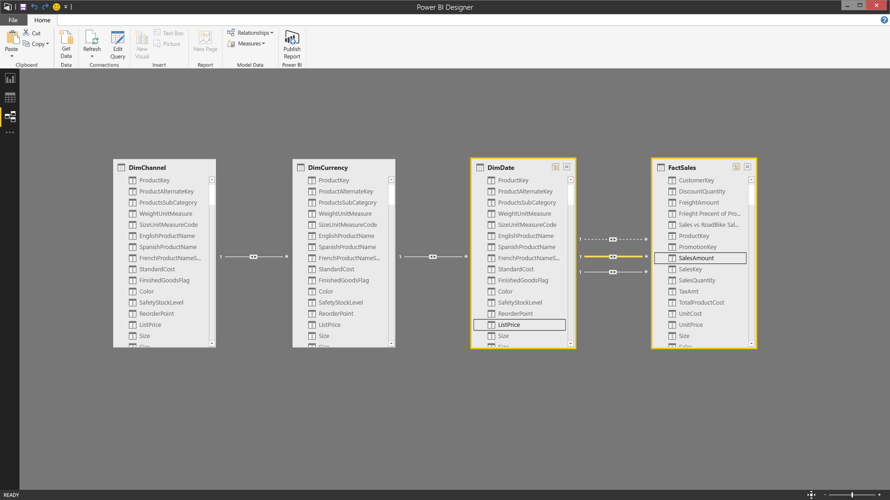
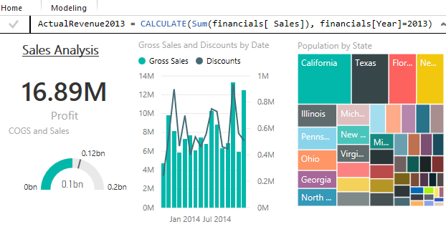
Produce rich data models using formulas and relationships
Power BI Desktop
Automatically create a model by importing data
Desktop detects relationships automatically, categorizes data and applies default summarization
Refine models to enable complex calculations
Create relationships between tables manually or using the AutoDetect feature
Adjust relationship type (1:1, many:many, m:1) and cross-filter data for new insights
Define calculations – known as measures – to generate new fields for use in reports
Use automatically generated measures, create custom measures, or create Calculated Tables with Data Analysis Expressions (DAX) formulas
Develop advanced analytics using a combination of measures and relationships
Uncover correlations, highlight exceptions and understand business outcomes
Prepare
Apply complex schema and business logic to create rich, reusable data models
Explore
Report
Create and modify relationships
Share &
collaborate
Define and use measures with DAX formulas
Notes:
Power BI Desktop enables extensive data analysis, enabling you to produce rich data models using formulas and relationships
Automatically create a model simply by importing data
Power BI Desktop detects relationships automatically, categorizes data and applies default summarization
Refine models to enable complex calculations
Identify relationships between datasets from a variety of sources
Create relationships between tables manually or using the AutoDetect feature
Desktop’s AutoDetect feature accelerates your analysis
Adjust relationship type (one-to-one, many-to-many or many-to-one) and cross-filter data for specific insights
Define calculations – known as measures – to generate new fields for use in reports. Measures create new information from existing data already in your model
Measures are used in some of the most common data analysis; for example, sums, averages, minimum or maximum values, counts, or more advanced calculations you create yourself using a DAX formula.
The calculated results of measures are always changing in response to your interaction with your reports, allowing for fast and dynamic ad-hoc data exploration
You can use automatically generated measures, or create custom measures with Data Analysis Expressions (DAX) formulas
This helps you enrich your data model
Produce exactly the results you need using the DAX library of 200+ formula elements
Use DAX library to create calculated tables too…
Develop advanced analytics using a combination of measures and relationships
Uncover correlations, highlight exceptions and understand business outcomes

Slide 11
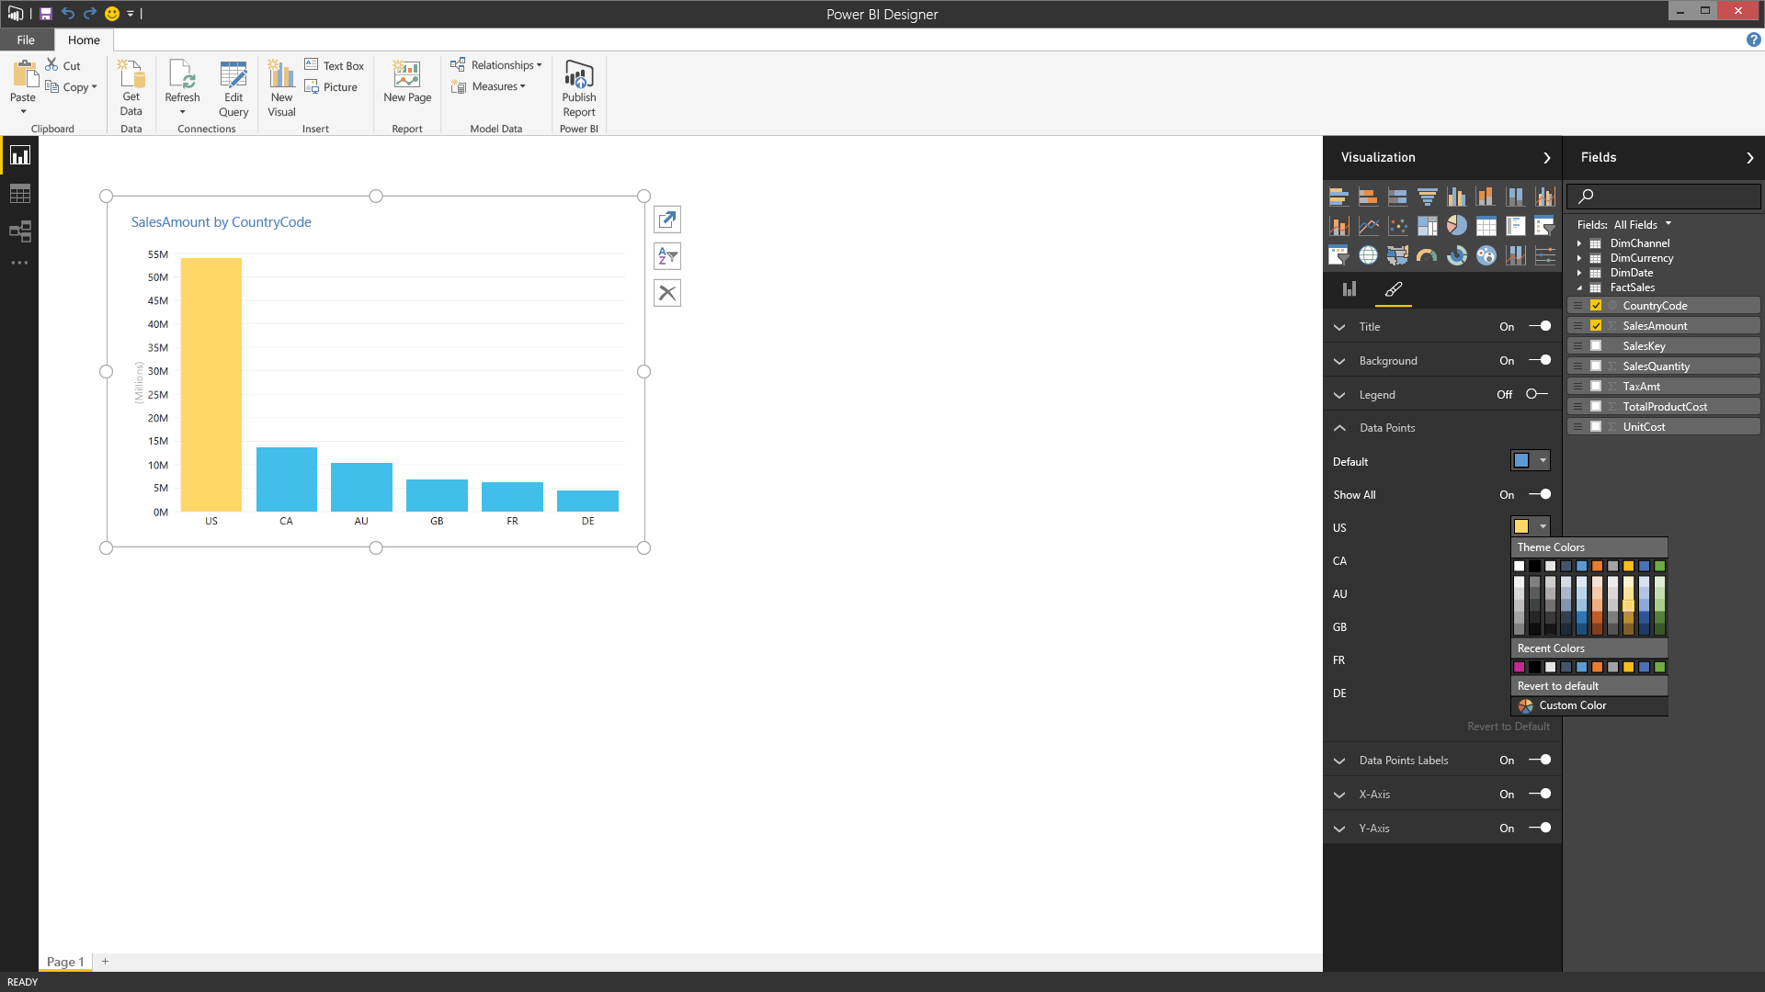
Power BI Desktop
Explore your data with freeform, drag and drop canvas
Explore data in a variety of ways and across multiple visualizations
Select data elements and sort data
Filter data and use cross-filter capabilities
Drill into and across datasets
Pivot and slice data
Change visualization types
Date sort and filters including Min & Max functions
Ability to refresh all views with a single click
Copy/Paste queries to/from Excel
Improved default sorting
Ability to sort the slicers
KPI Consumption when connecting to Analysis Services or importing Excel Workbooks with Data Model KPIs (Preview Feature)
Select, transform and mashup data via a freeform, drag-and-drop canvas
Prepare
Explore
Power BI Desktop allows you to explore your data and create insightful visualizations on a freeform canvas
Report
Share &
collaborate
Notes:
The reporting step is where the visual data exploration enabled by Power BI Desktop really comes to life
Note: you can move directly from connecting to (importing) data to reporting – data preparation, modeling, and analysis are optional intermediate steps. Because Power BI Desktop automatically creates a data model for you upon data import, you can immediate generate reports
Power BI Desktop enables you to visualize data in a number of ways and easily author reports
Depict data in compelling reports that tell stories using a range of interactive visualization
Use data from different sources in a single, consolidated report – create relationships between different data sources to create a data model, that you can then use in a report
You can select, transform and mashup data via a freeform, drag-and-drop canvas
Explore data in a variety of ways and across multiple visualizations
Select data elements and sort data
Filter data, leveraging cross-filter capability
Drill into and across datasets
Pivot and slice data
Change visualization types

Slide 12
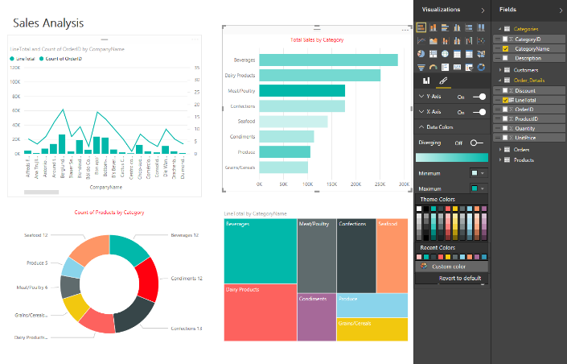
Deliver valuable insights with customizable visual reports
Power BI Desktop
Visualize data and author reports
Depict data in compelling reports that tell stories using a range of interactive visualizations
Use data from many sources in a single, consolidated report
Create relationships via drag & drop between 2 tables
Apply filters in visualization, page, and reports
Ability to drill down/up in column and scatter charts
Support for inserting Shapes in the Report canvas
Expand/Collapse All for multiple tables in Fields pane
Adjust reports to fit various screen sizes
Rename and delete tables and columns
Support for median, standard deviation, and variance
Ability to incorporate custom visualizations
Change color, format and customize
Adjust Title, Background Color, Legend, Data Labels including color saturation values
Change X-Axis label direction
New visual color formatting with fixed and data driven settings
Linear or Logarithmic scales for values in Y-axis
Prepare
Explore
Report
Power BI Desktop allows you to create and customize reports that tell visually compelling data stories
Share &
collaborate
Notes:
The reporting step is where the visual data exploration enabled by Power BI Desktop really comes to life
Note: you can move directly from connecting to (importing) data to reporting – data preparation, modeling, and analysis are optional intermediate steps. Because Power BI Desktop automatically creates a data model for you upon data import, you can immediate generate reports
Power BI Desktop enables you to visualize data in a number of ways and easily author reports
Depict data in compelling reports that tell stories using a range of interactive visualization
Use data from different sources in a single, consolidated report – create relationships between different data sources to create a data model, that you can then use in a report
You can select, transform and mashup data via a freeform, drag-and-drop canvas
Explore data in a variety of ways and across multiple visualizations
Select data elements and sort data
Filter data, leveraging cross-filter capability
Drill into and across datasets
Pivot and slice data
Change visualization types

Slide 13
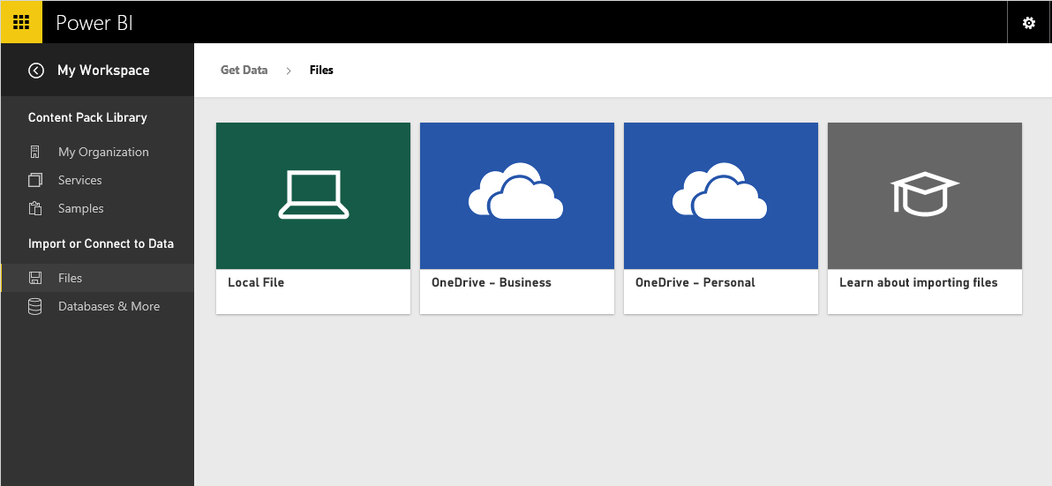
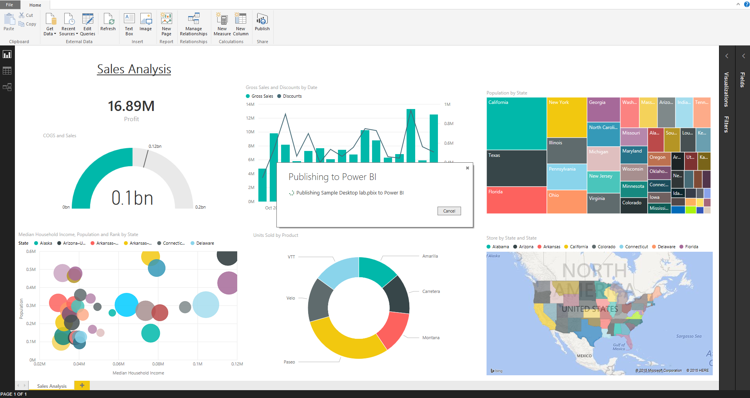
Power BI Desktop
Share reports, visualizations and data with a broad audience
Prepare
Save Power BI Desktop report files and easily publish them to Power BI
Share as appropriate with other Power BI users in your organization
Changes to dashboards automatically sync across all users
Copy table, cells or columns to clipboard
Explore
Import Power BI Desktop file in Power BI service
Report
Share &
collaborate
Publish from Power BI Desktop to Power BI service
Notes:
Once you are ready to publish your report and the visualizations within it, you can surface it to a broader audience by publishing to the Power BI service
Save the Power BI Desktop file, then go into the Get Data interface on powerbi.com to upload the report and share it with others
This enables you to give Power BI users access to richer data models and reports than they could create on their own

Slide 14
Demos

Slide 15
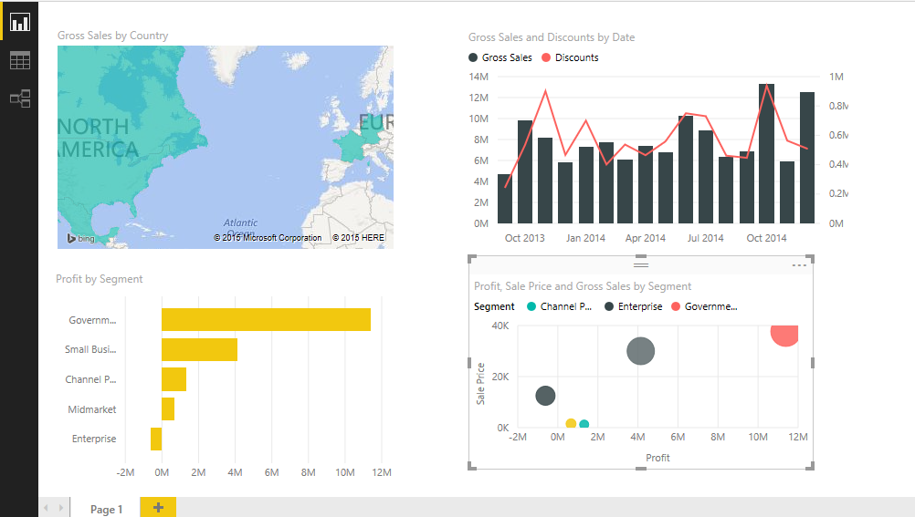
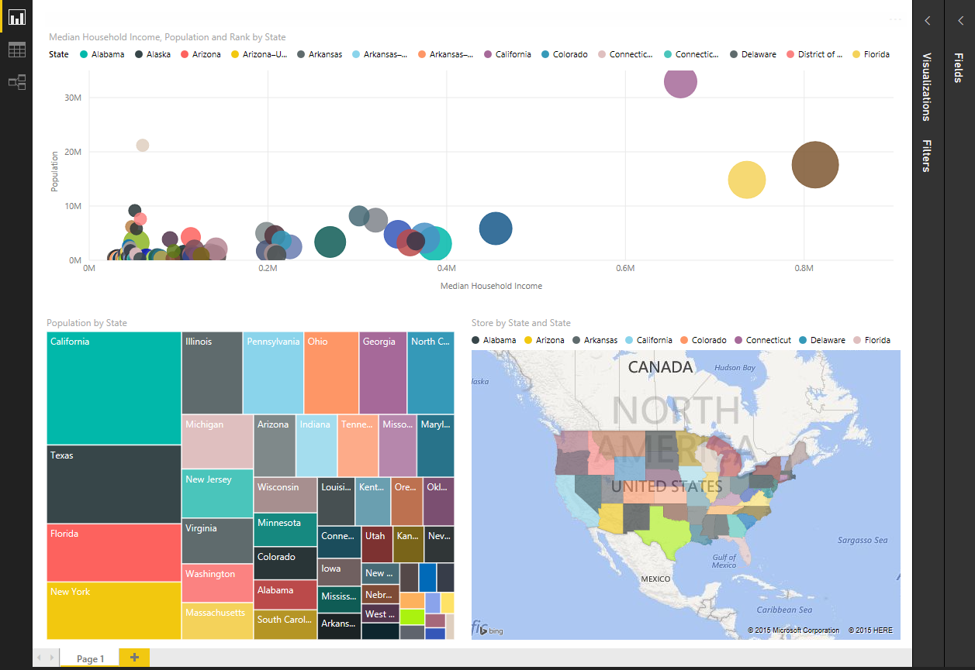
10 min. Power BI Desktop Demos
Instructions
Sample data
Financial sample:
Model and design dashboards
with Power BI Desktop
2) Query and reporting sample:
Query and reporting sample Prepare a data model and create a report

Slide 16
Appendix: DAX Functions

Slide 17
New DAX functions
DATEDIFF SELECTCOLUMNS
PERCENTILE(X) SUMMARIZECOLUMNS
CONCATENATE(X) GROUPBY
MEDIAN(X) UNION
GEOMEAN(X)
PRODUCT(X)
XIRR
XNPV

Slide 18
Median(X)
The MEDIAN function returns the median of the numbers in a column. The MEDIANX function returns the median of an expression evaluated for each row in a table.
Syntax:
=MEDIANX( ALLSELECTED(Product[ProductName])
,[Sum of RevenueAmount])

Slide 19
Percentile(X)
Returns the k-th percentile of values in a range, where k is in the range 0..1, inclusive or exclusive.
You can use this function to establish a threshold of acceptance. For example, you can decide to examine candidates who score above the 90th percentile.
Syntax:
PERCENTILE.INC (Column, K) or PERCENTILE.EXC (Column, K)
PERCENTILEX.INC (Table, Expression, K) or
PERCENTILEX.EXC (Table, Expression, K)
PERCENTILEX.INC (Product
,[Sum of RevenueAmount],0.9)

Slide 20
DATEDIFF
Returns the count of the specified interval boundaries crossed between two dates.
Syntax:
DATEDIFF(<interval>, <start_date>, <end_date>)

Slide 21
XNPV
The XNPV function returns the net present value for a schedule of cash flows that is not necessarily periodic.
Syntax: XNPV(<table>, <values>, <dates>, <rate>)
Present value := XNPV( CashFlows,
[Payment], [Date], 0.09 )
= 2086.65
Date | Payment
1/1/2014 | -10000
3/1/2014 | 2750
10/30/2014 | 4250
2/15/2015 | 3250
4/1/2015 | 2750

Slide 22
PRODUCT(X)
Returns the product of an expression evaluated for each row in a table.
Future investment= [Sum of RevenueAmount] * Productx(Rates,1+[Rates])
The PRODUCTX function takes as its first argument a table,
or an expression that returns a table. The second argument is a column that contains the numbers for which you want to compute the product, or an expression that evaluates to a column.
Rates
5.0%
4.0%
3.5%
2.0%
3.0%
5.0%

Slide 23
DAX Expressions for relationships
CrossFilter( FK, PK, direction )
Similar to UseRelationship, you can change the filter direction
Direction: both, one, none
Calculate( [My measure], CrossFilter( … ) )

Slide 24
CrossFilter(FK, PK, direction)
Count of Customers = //filters through Sales by default Calculate( CountRows( Customer ) )
Count of Customers using Region = Calculate( [Count of Customers], //Cut filtering between Sales and Customer, then use the inactive relationship CrossFilter( Sales[CustomerId], Customer[Id], none ), UseRelationship ( Customer[RegionId], Region[Id] ) )
Count of Customers using Sales and Region = Calculate( [Count of Customers], //filters through Sales by default
//Filter Customers to only those in remaining Regions Filter( Customer, Contains( Region, [Id], Customer[RegionId] ) ) )

